Slide 1

Result Generator
There are 20 students in your class. Input the marks of all subjects and show the grade of students after required calculation. Subjects and credit are shown below. Requirement and specification:
• Input the marks against all subjects.
• Do required calculation
• Show the students ID and the grade
• Sort the students according to the grade
• Count how much students got which grade

Slide 2
PROJECT SUBMISSION
Course Title : Programming and Problem Solving/LAB
Course Code : CSE-113/114
Course Tutor
DR. SHEAK RASHED HAIDER NOORI
PROFESSOR & ASSOCIATE HEAD
Department of COMPUTER SCIENCE AND ENGINEERING

Slide 3
Result Generator
We have used:
1.File
2.Structure
3.Function
4.String
5.Loop
6.Condition
7.Array
8.Mathematical Expression

Slide 4




Team : Sign_In
MD. Mubarak Hossain Razwan
ID:0242310005101027
S M Sadman Al Siam
Masud Rana Nayeem
MD. SAZZADUL ISLAM SHAON
ID : 0242310005101849
ID : 0242310005101123
ID : 0242310005101028

Slide 5
INTRODUCTION
MD. SAZZADUL ISLAM SHAON
My topic is :
TAKE INPUT AGAINST ALL SUBJECT AND DO REQUIRED CALCULATIONS

Slide 6


IN MY PART , I’VE USED
CONDITIONS
CALCULATIONS

Slide 7
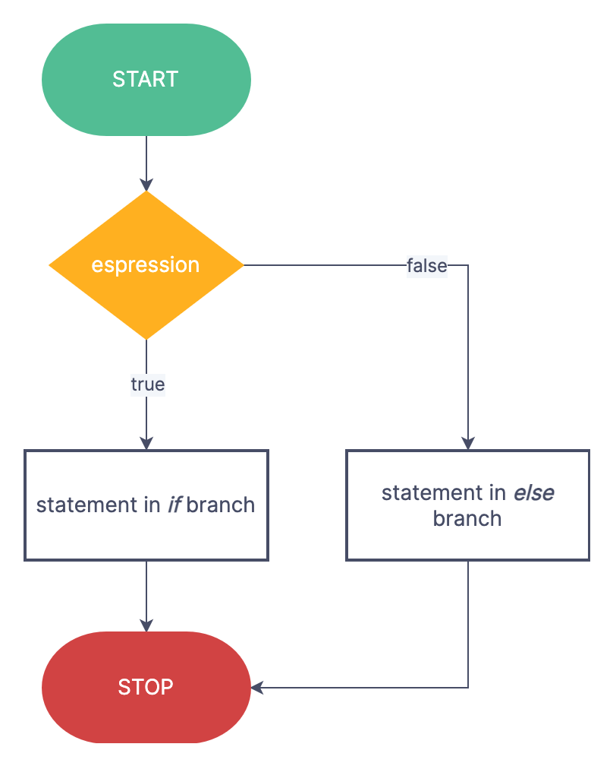
CONDITIONS
How if statement works?
The if statement evaluates the test expression inside the parenthesis ().
If the test expression is evaluated to true, statements inside the body of if are executed.
If the test expression is evaluated to false, statements inside the body of if are not executed.

Slide 8

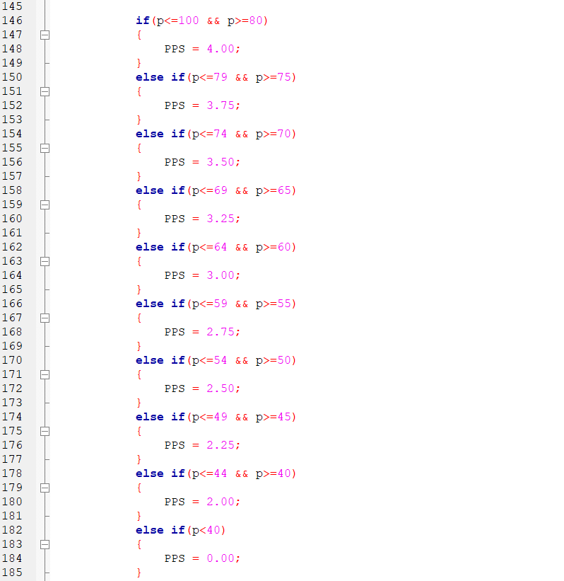
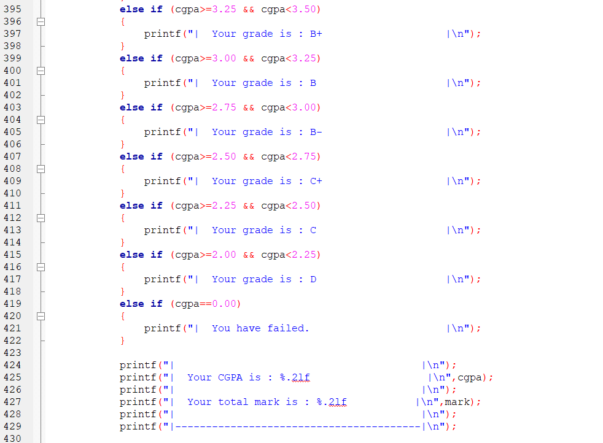
HERE I’VE USED IF-ELSE CONDITIONS TO GET THE PROPER OUTPUT AFTER THE CGPA CALCULATIONS

Slide 9
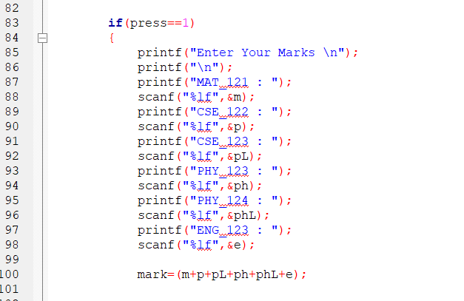
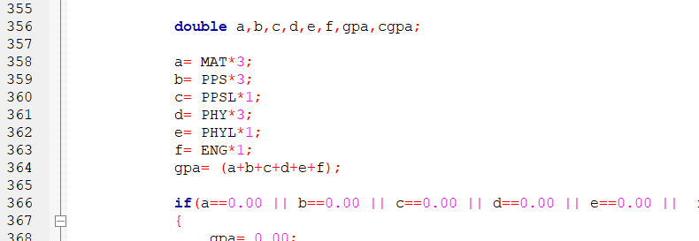
CALCULATIONS
IN THIS PART I TOOK THE INPUT FROM THE USER IN FORM OF INTEGERS AND CALCULATE THE CGPA USING MATHEMATICAL EXPRESSIONS .

Slide 10
INTRODUCTION
Masud Rana Nayeem
My presentation topic is :
Show the students ID and the grade

Slide 11

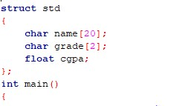
HOW TO WORK STRUCTURE
STEP 01
Create a structure variable
Once the structure has been defined, you can create a structure variable. This is done by using the struct keyword followed by the name of the structure. The syntax for creating a structure variable is as follows
STEP 02
Define the structure
The first step is to define the structure. This is done using the struct keyword. The syntax for defining a structure is as follows..

Slide 12
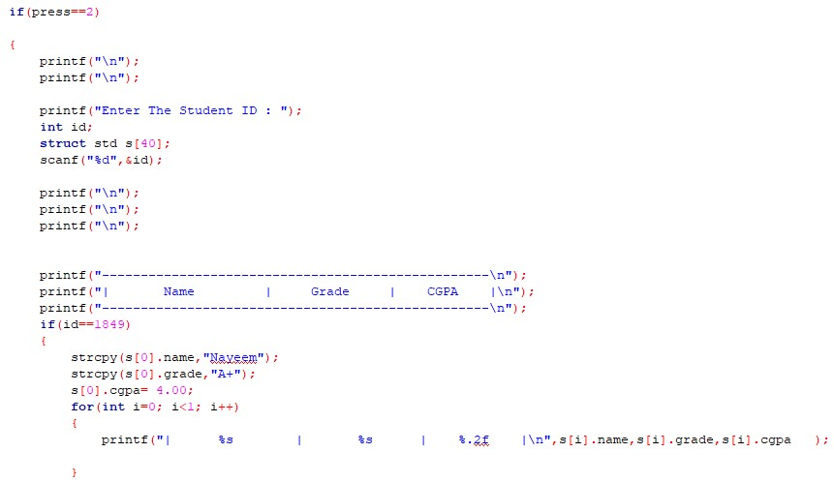
MY PROJECTS
In my project .I use two major parts in here..
1.Structure.
2.Condition.
3.Loop.

Slide 13
INTRODUCTION
MD. MUBARAK HOSSAIN RAZWAN
My topic is :
Sort the students according to the grade

Slide 14
In This Part , I’ve Used
Function
Structure
For Loop
Condition

Slide 15
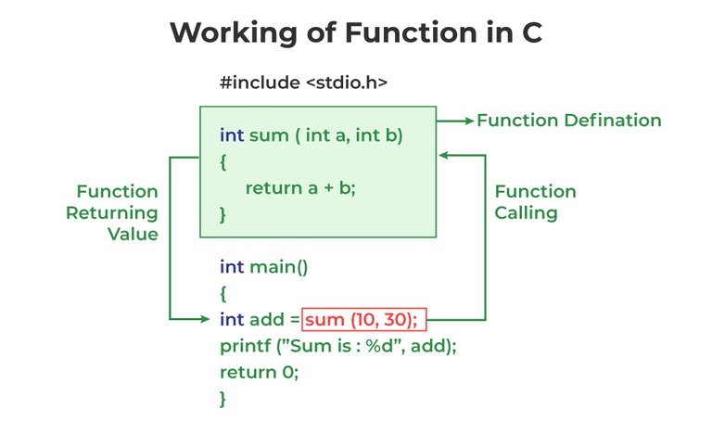
Function
Functions in C programming are like reusable tools that perform specific tasks.
- They help break down complex problems into smaller, manageable pieces.
- Functions have a name and can accept inputs (arguments).
- Functions can return a value back to the code that called them.
- Using functions makes code more organized and easier to read.
- Functions can be used multiple times in different parts of a program.
- They make it easier to debug and maintain code.
- Functions allow for code reusability and promote efficient programming practices.

Slide 16
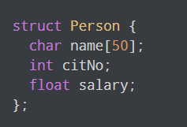
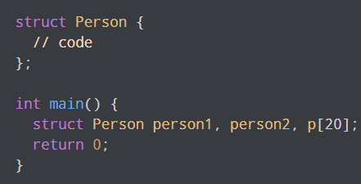
Structure
Structures (also called structs) are a way to group several related variables into one place. Each variable in the structure is known as a member of the structure.
Unlike an array, a structure can contain many different data types (int, float, char, etc.).
You can create a structure by using the (struct) keyword and declare each of its members inside curly braces:
When a struct type is declared, no storage or memory is allocated. To allocate memory of a given structure type and work with it, we need to create variables.

Slide 17
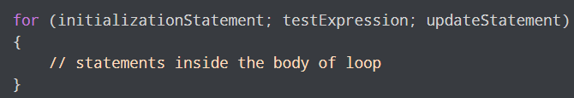
For Loop
How for loop works?
The initialization statement is executed only once.
Then, the test expression is evaluated. If the test expression is evaluated to false, the for loop is terminated.
However, if the test expression is evaluated to true, statements inside the body of the for loop are executed, and the update expression is updated.
Again the test expression is evaluated.
This process goes on until the test expression is false. When the test expression is false, the loop terminates.

Slide 18
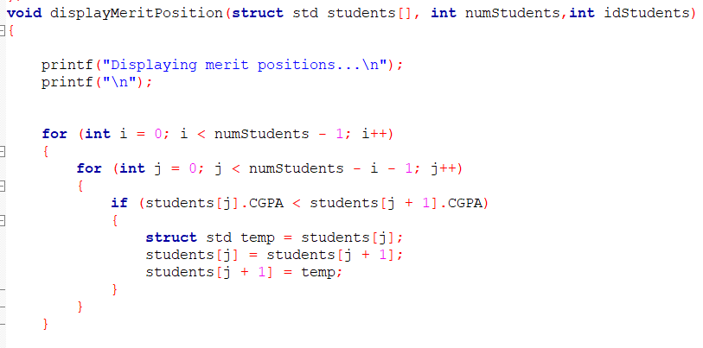
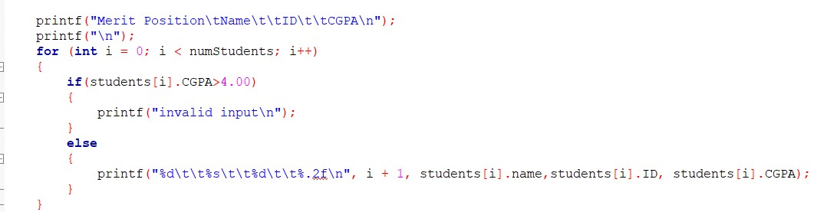
Using Function
Here I have used For Loop,Structure and Condition to sort merit list serially .
Here I have used loop,condition,printf to sort merit list & print.

Slide 19
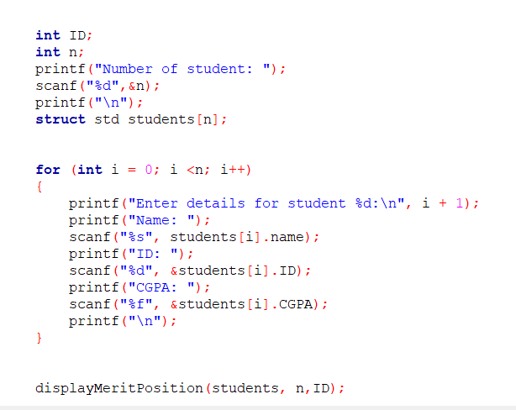
In this main function I called the user define function and printed the received data.

Slide 20
INTRODUCTION
S M Sadman Al Siam
My presentation topic is :
Count how much students got which grade

Slide 21
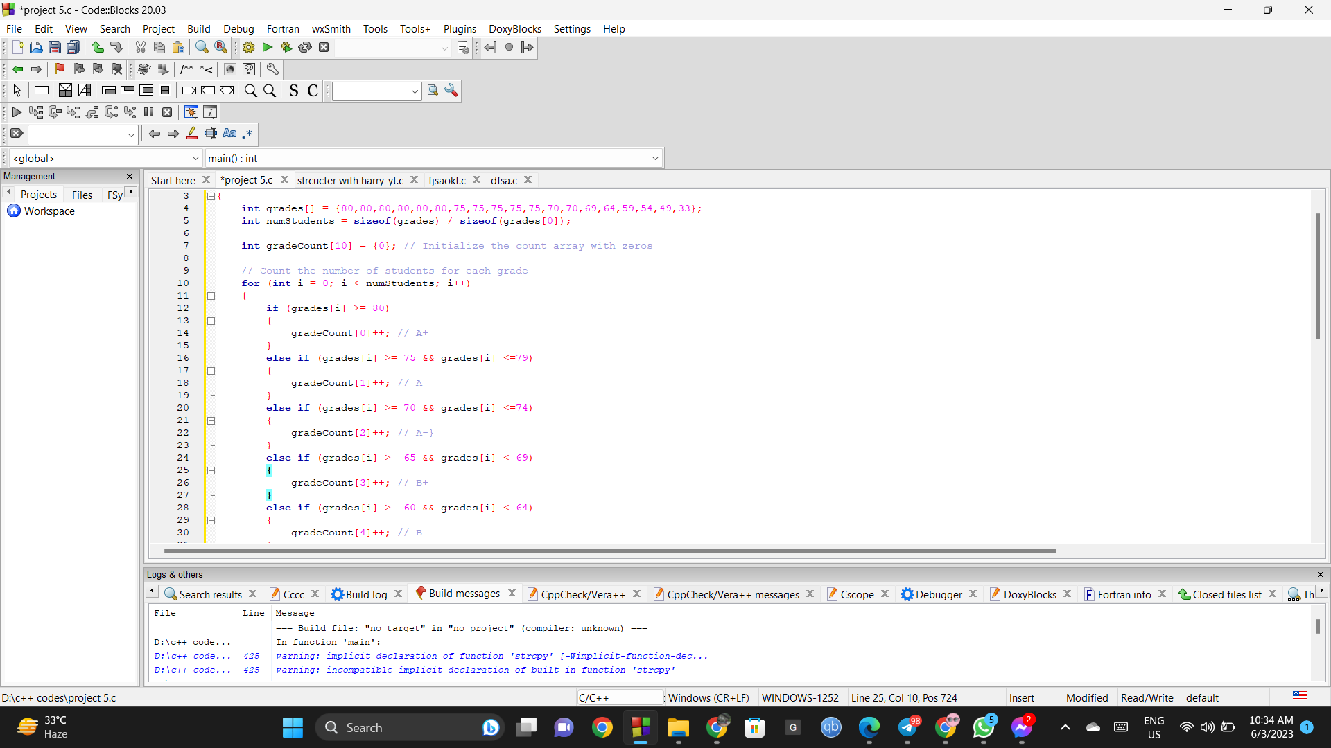
Count how much students got which grade
We Use Three major parts in here..
1.Array.
2.For loop.
3.Condition.

Slide 22
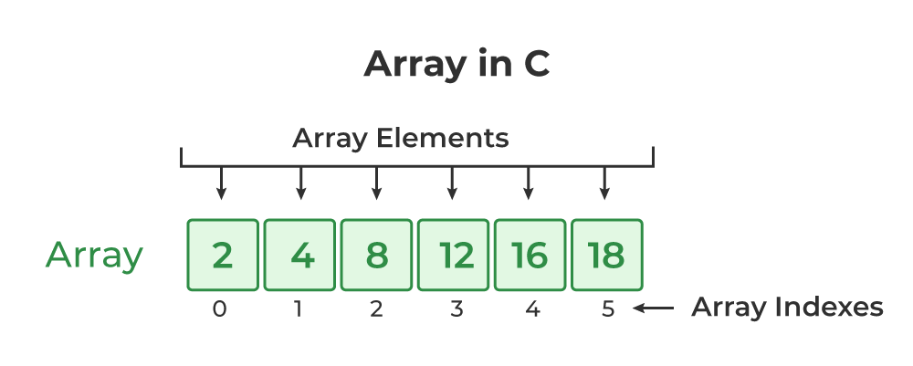
Array
STEP 01
Array Declaration:
Data_type_array_name[array-size];
STEP 02
Array initialization:
int marks[3]
Array size_5
marks[0] marks[1] marks[2]
80 65 90
marks[0] = 80;
marks[1] = 65;
marks[2] = 90;

Slide 23
For loop & Conditions
FOR LOOP-
repeating the same process multiple times until a specific condition satisfies.
for (initial value; condition; incrementation or decrementation )
{
statements;
}
CONDITIONS-
Use if to specUse if to specify a block of code to be executed, if a specified condition is true.
(Syntax)
for(i=0;i<n;i++)
if (test expression1) {
// statement(s)
}
else if(test expression2) {
// statement(s)
}
else if (test expression3) {
// statement(s)
}
.
.
else {
// statement(s)
}

Slide 24
THANK YOU

